Slide 1
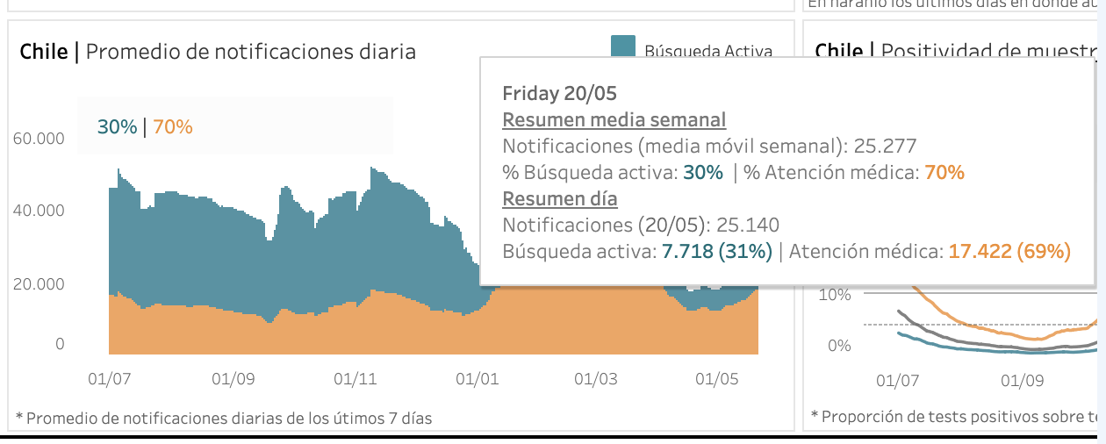
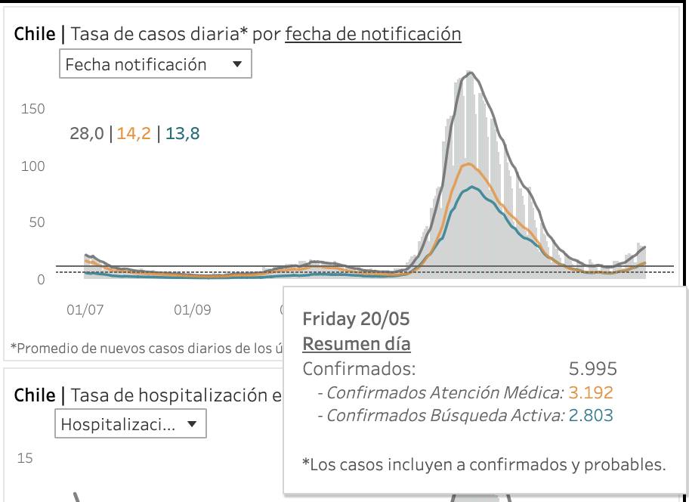

Slide 2
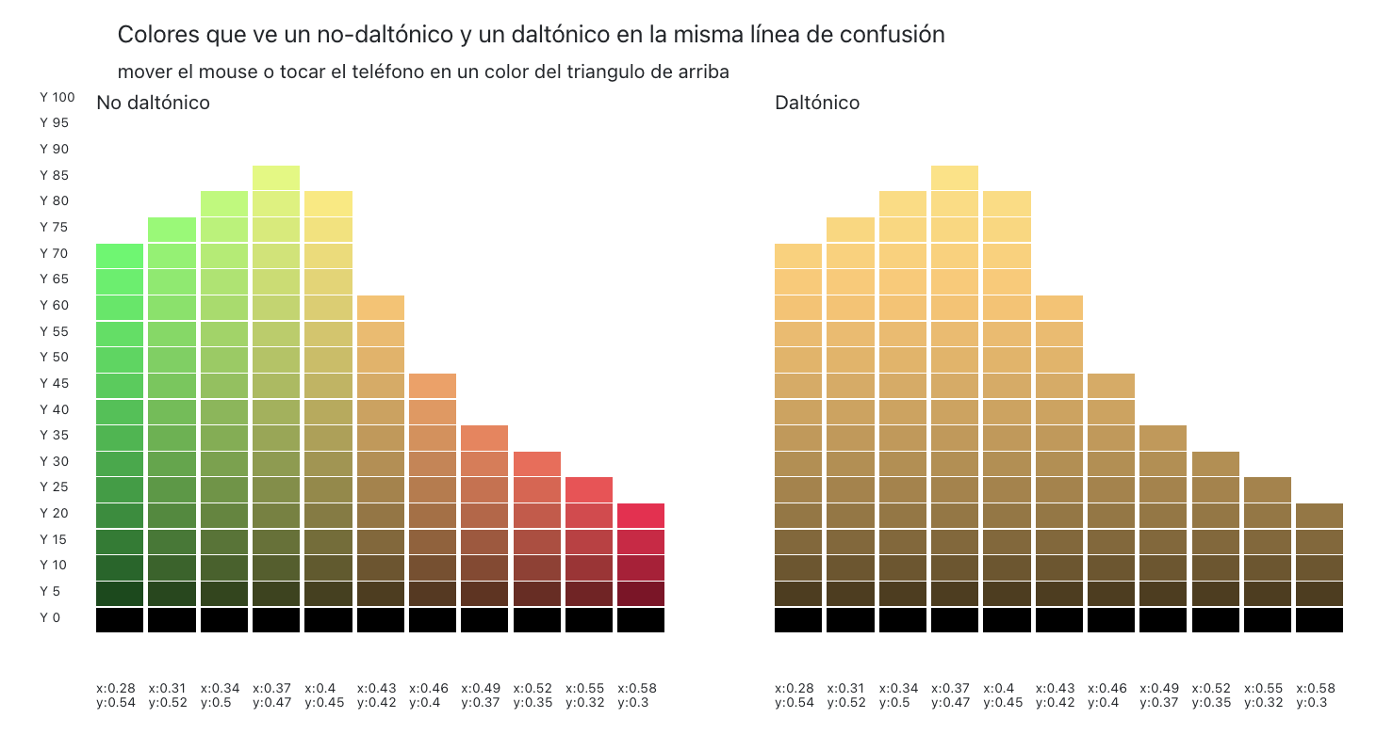
00FB5C
DCCB63
FFD06F
FFC96B

Slide 3
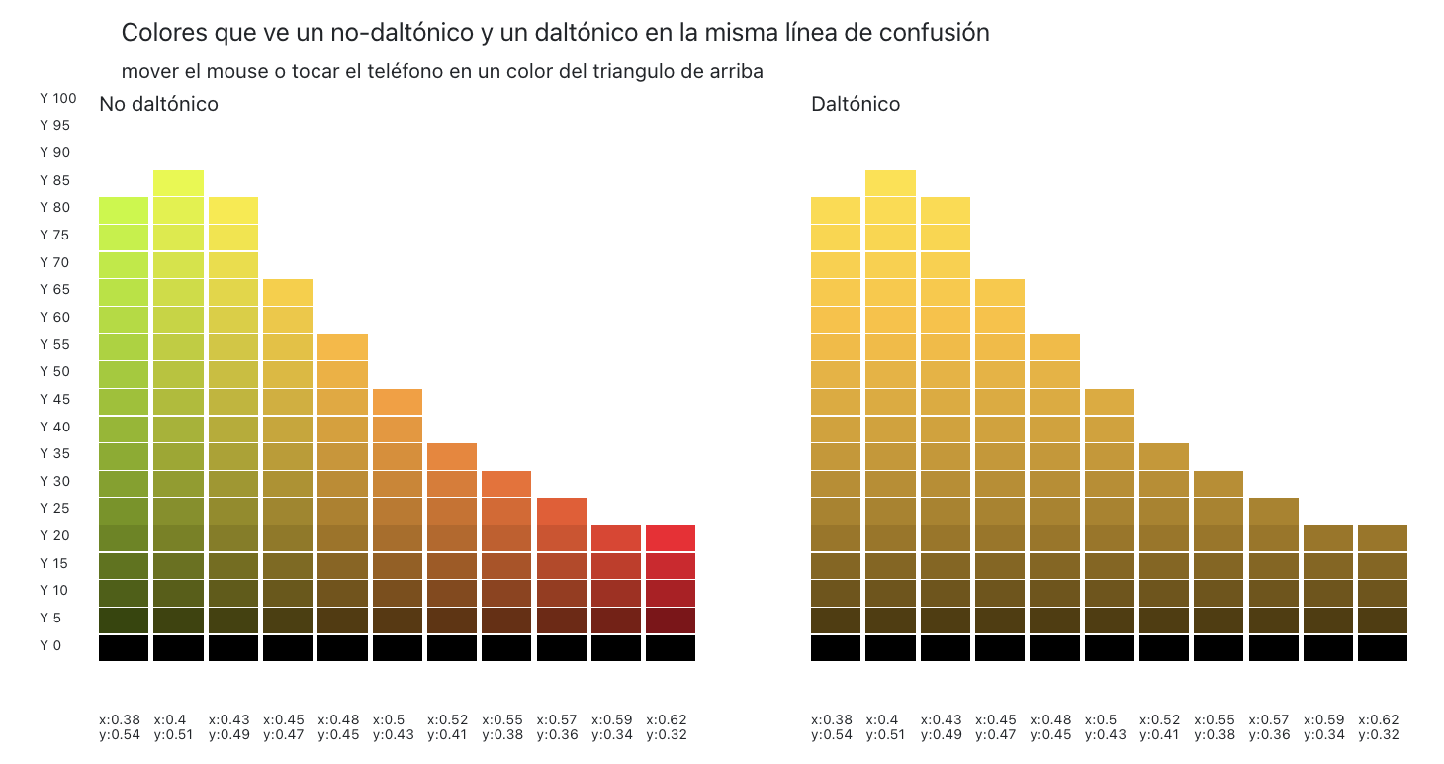
B6001B
814D0D
72540A
73540A

Slide 4
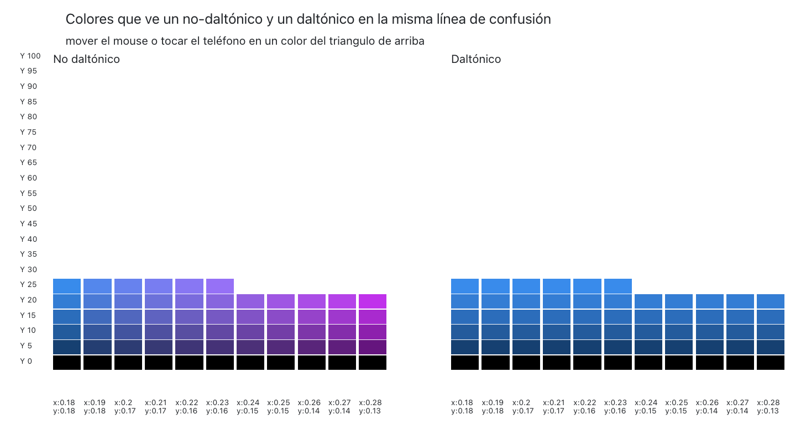
255A9C
9900B4
025BA1
035BA1

Slide 5
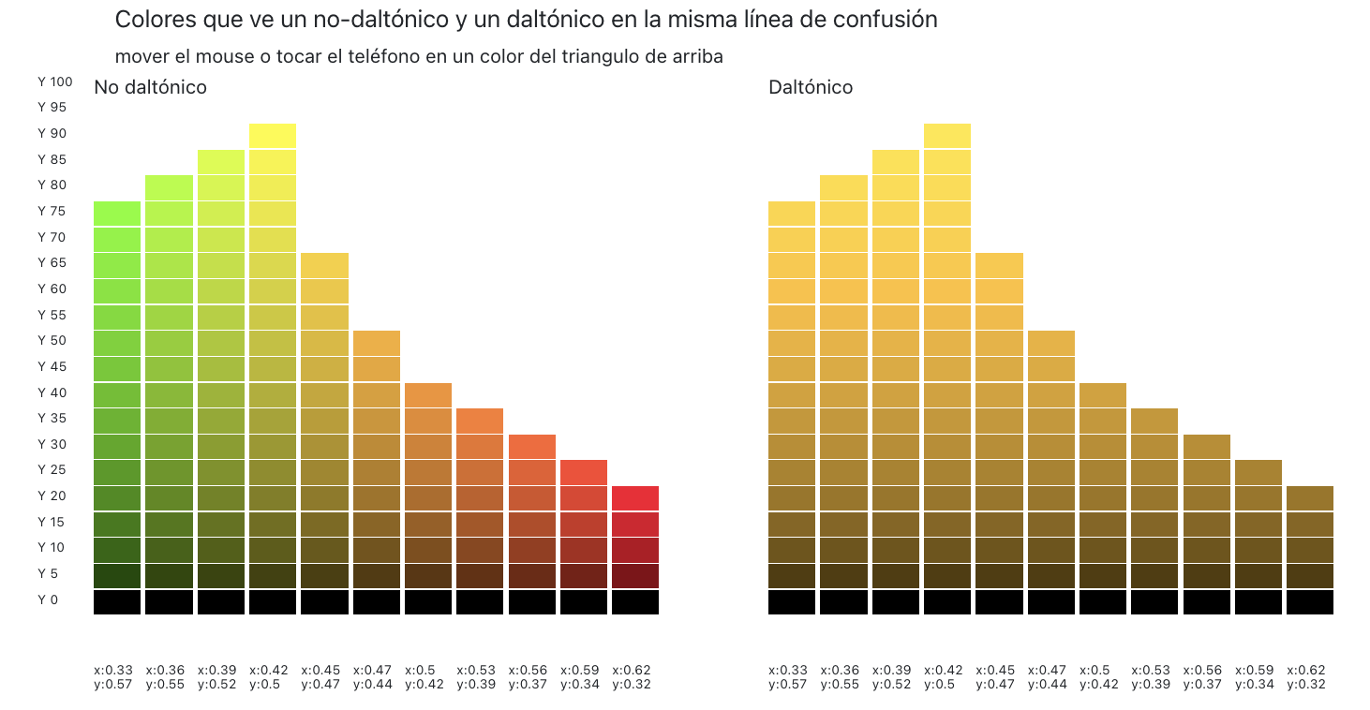
558927
A37219
F8002C
9D7516
9D7516
9D7516

